Slide 1
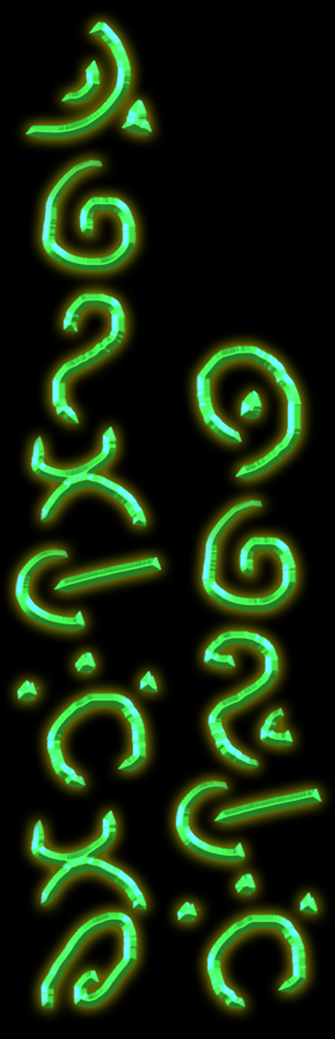
Taliesin games Character style guide

Slide 2
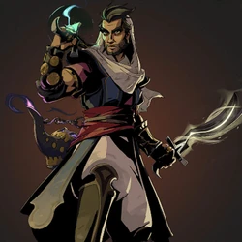
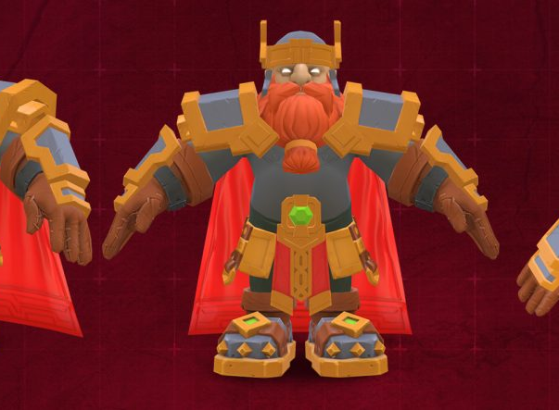
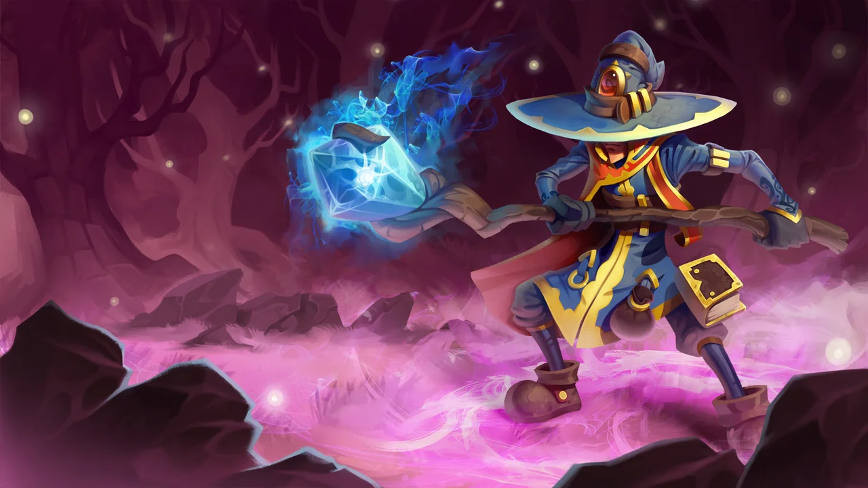
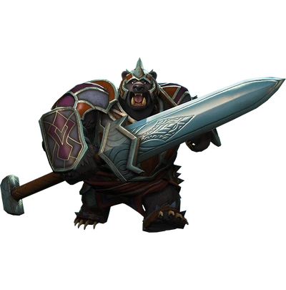
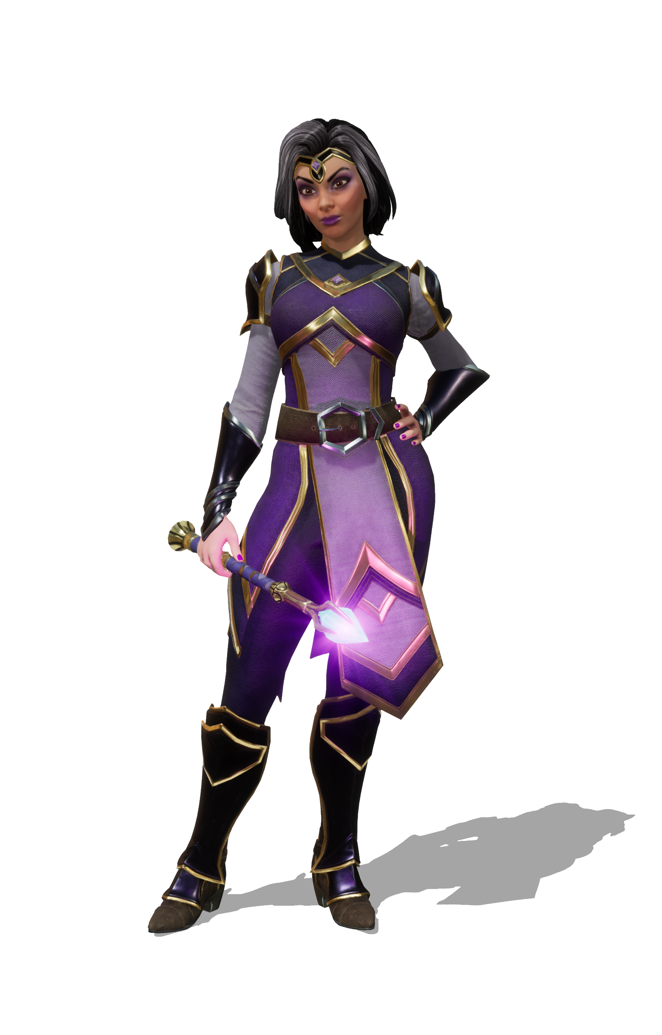
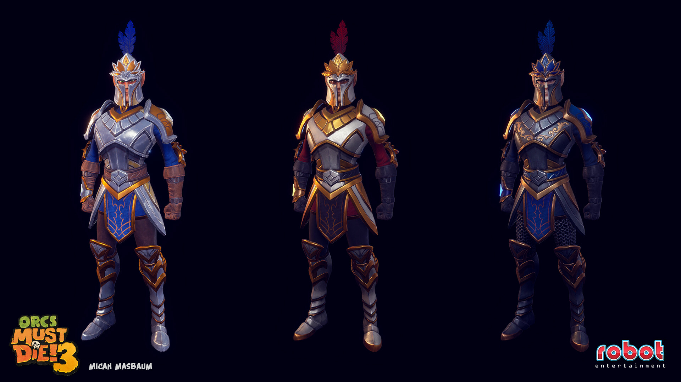
Hero Characters (Sculpting)

Slide 3
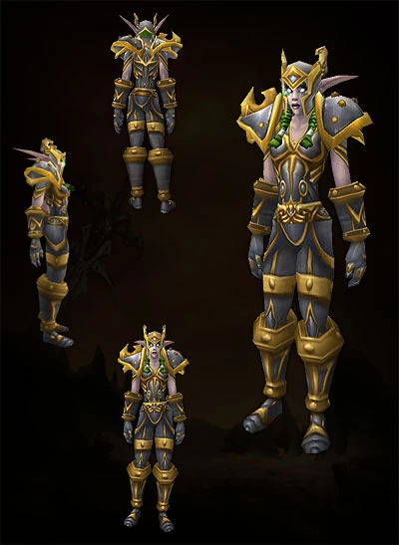
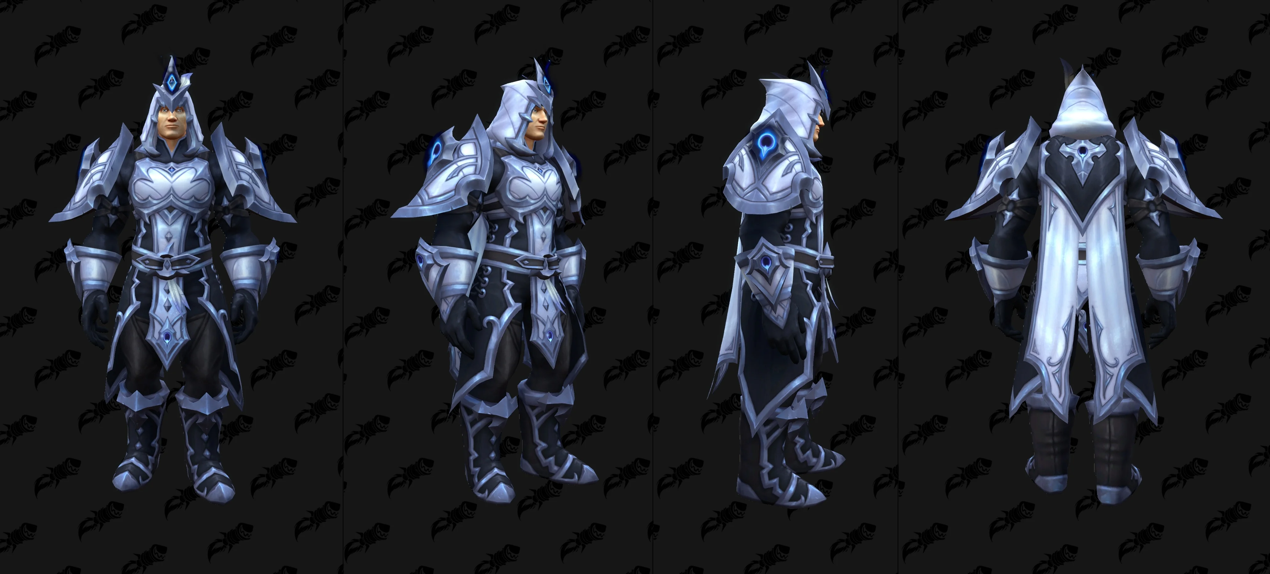
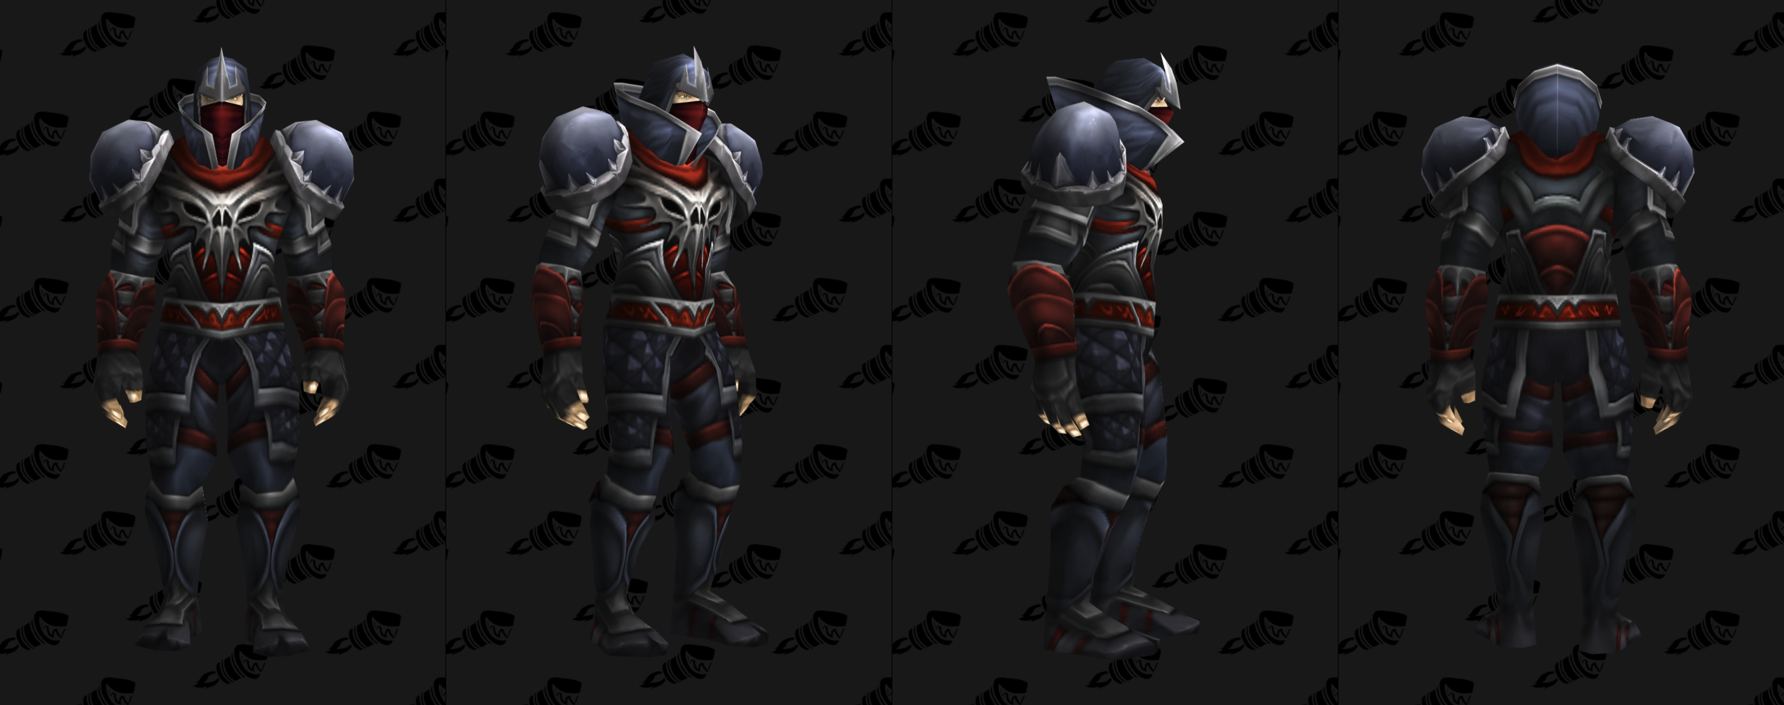
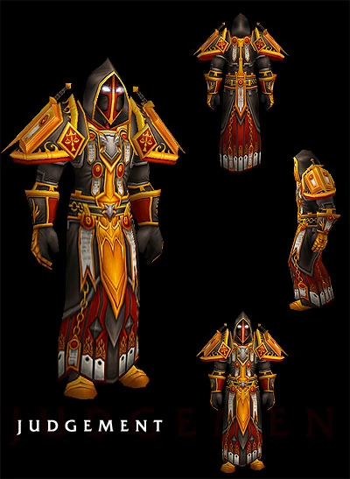
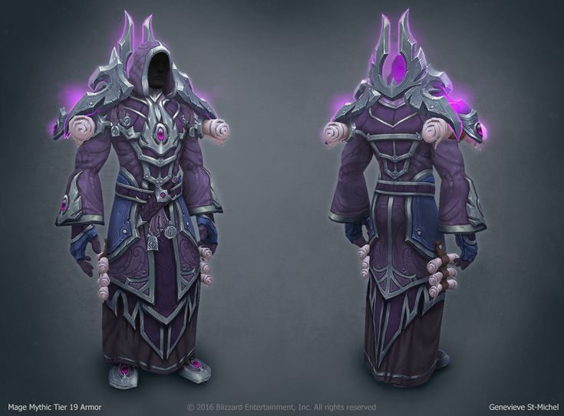
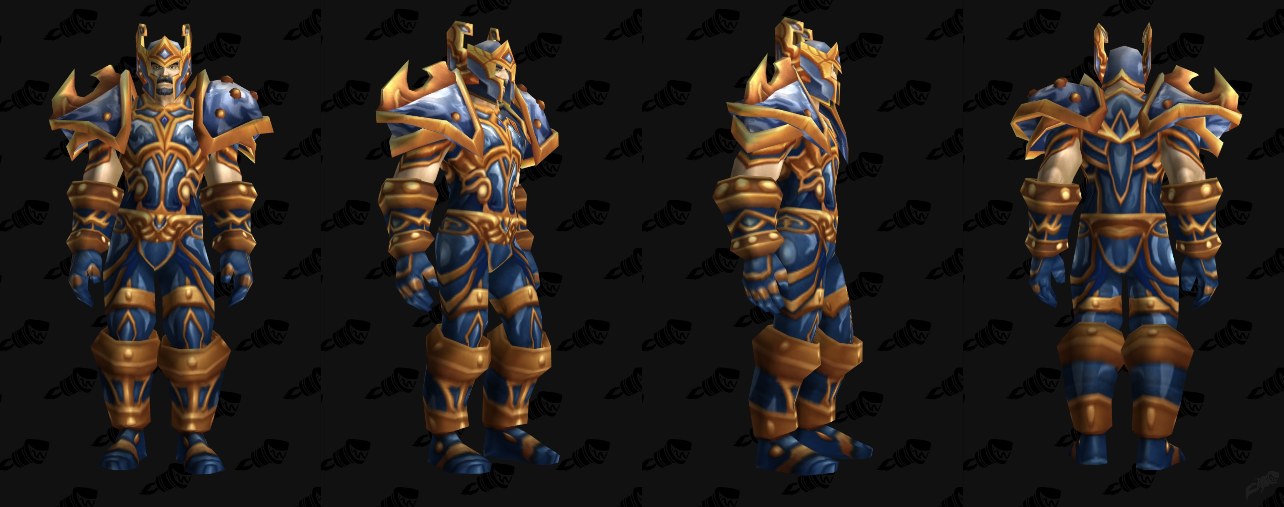
Hero Armour types (Sculpting)
Knight
Paladin
Rogue
Warrior
Mage
Hunter

Slide 4
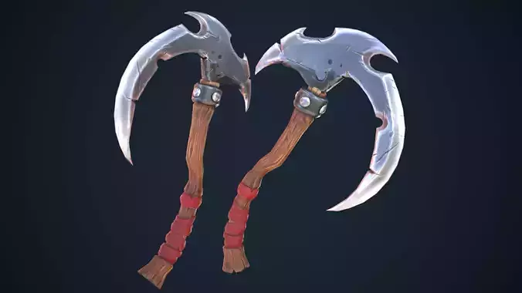
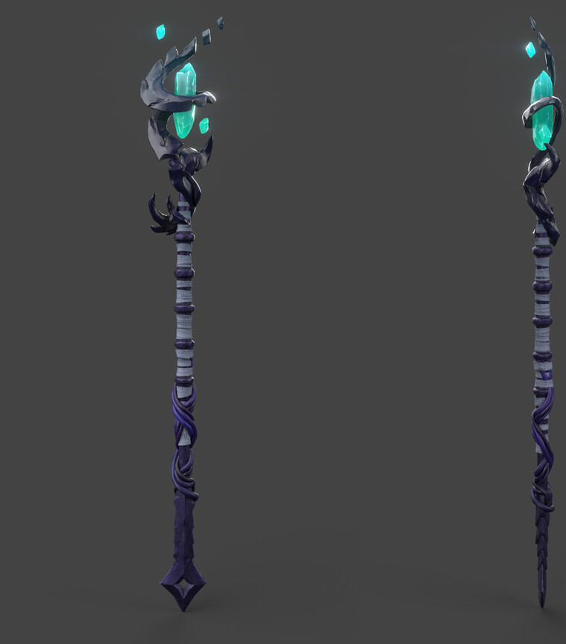
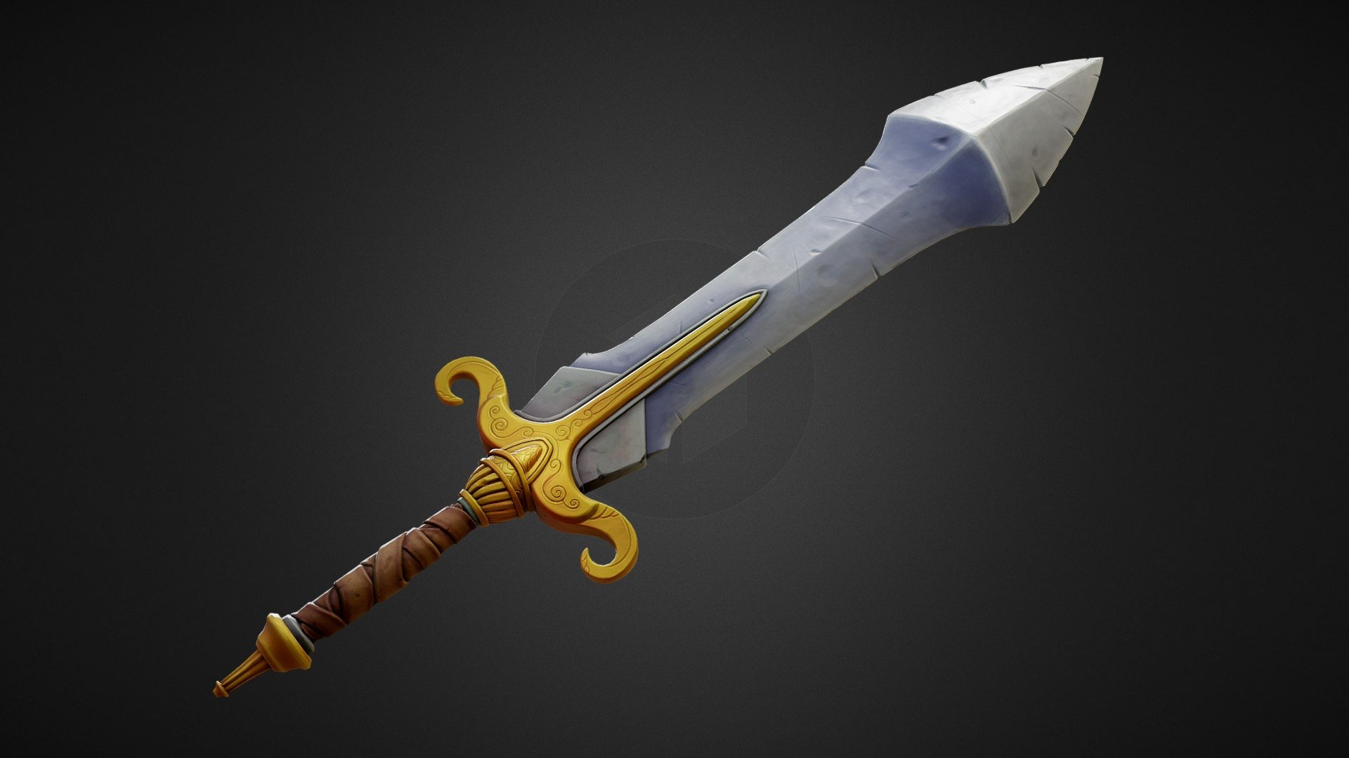
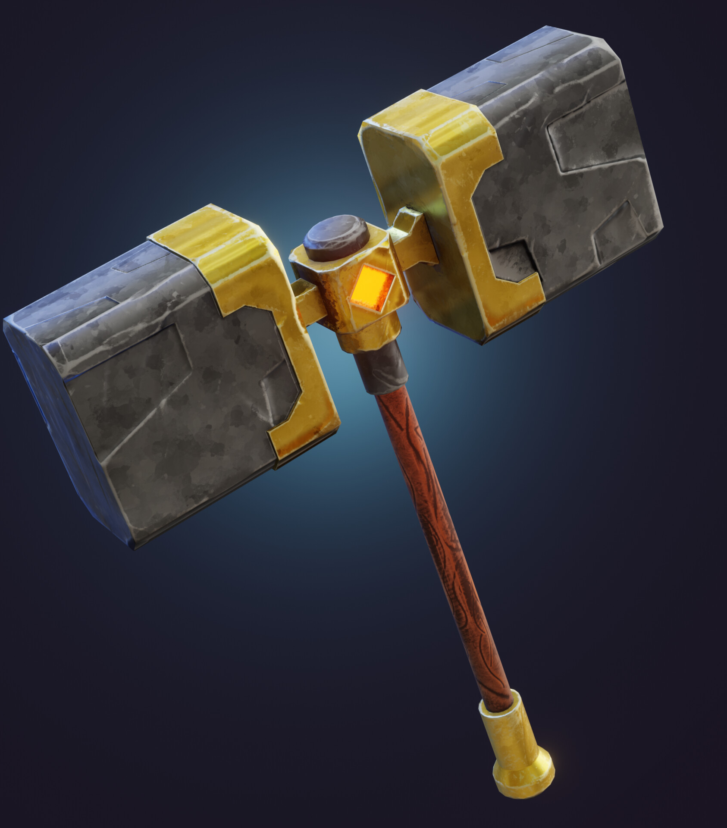
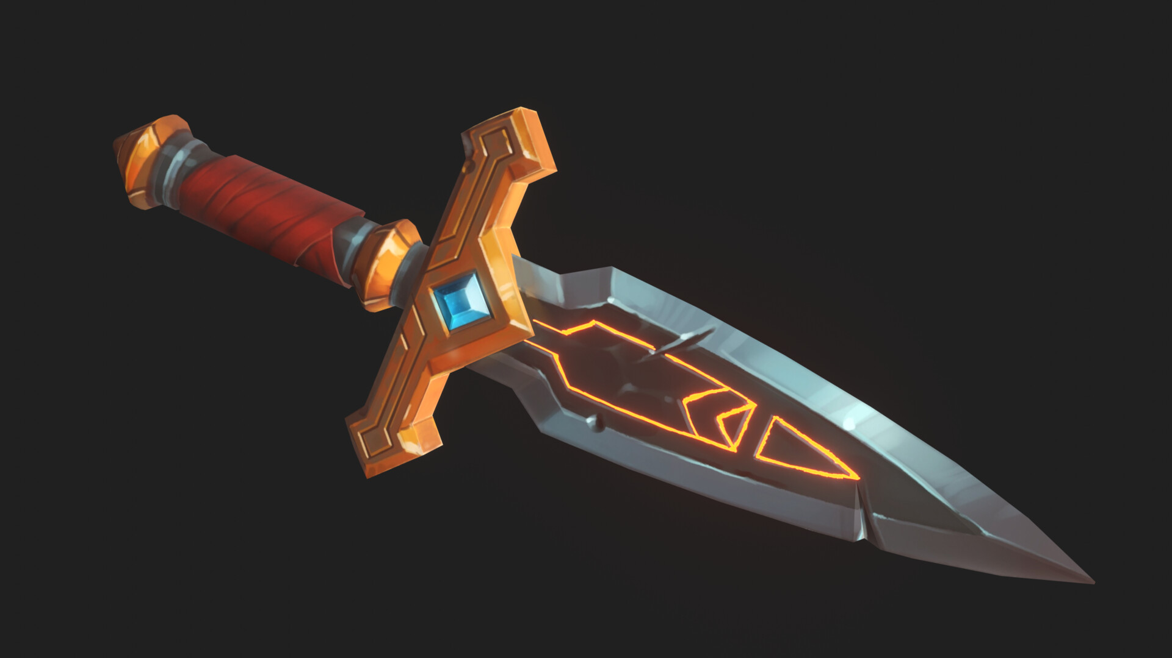
Hero Player weapons (Sculpting)
Duel-wielding Scythes
Sword
War Hammer
Mage Staff
Dagger

Slide 5
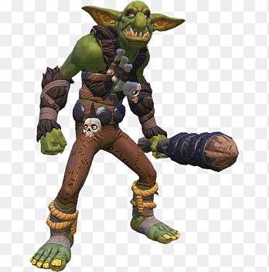
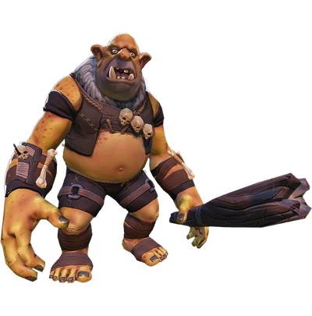
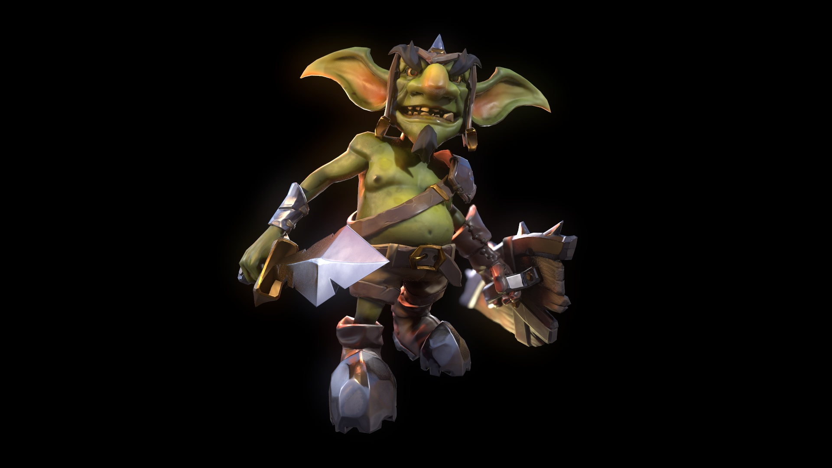
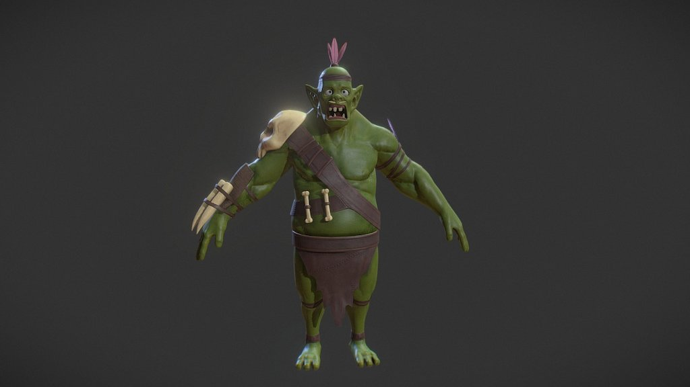
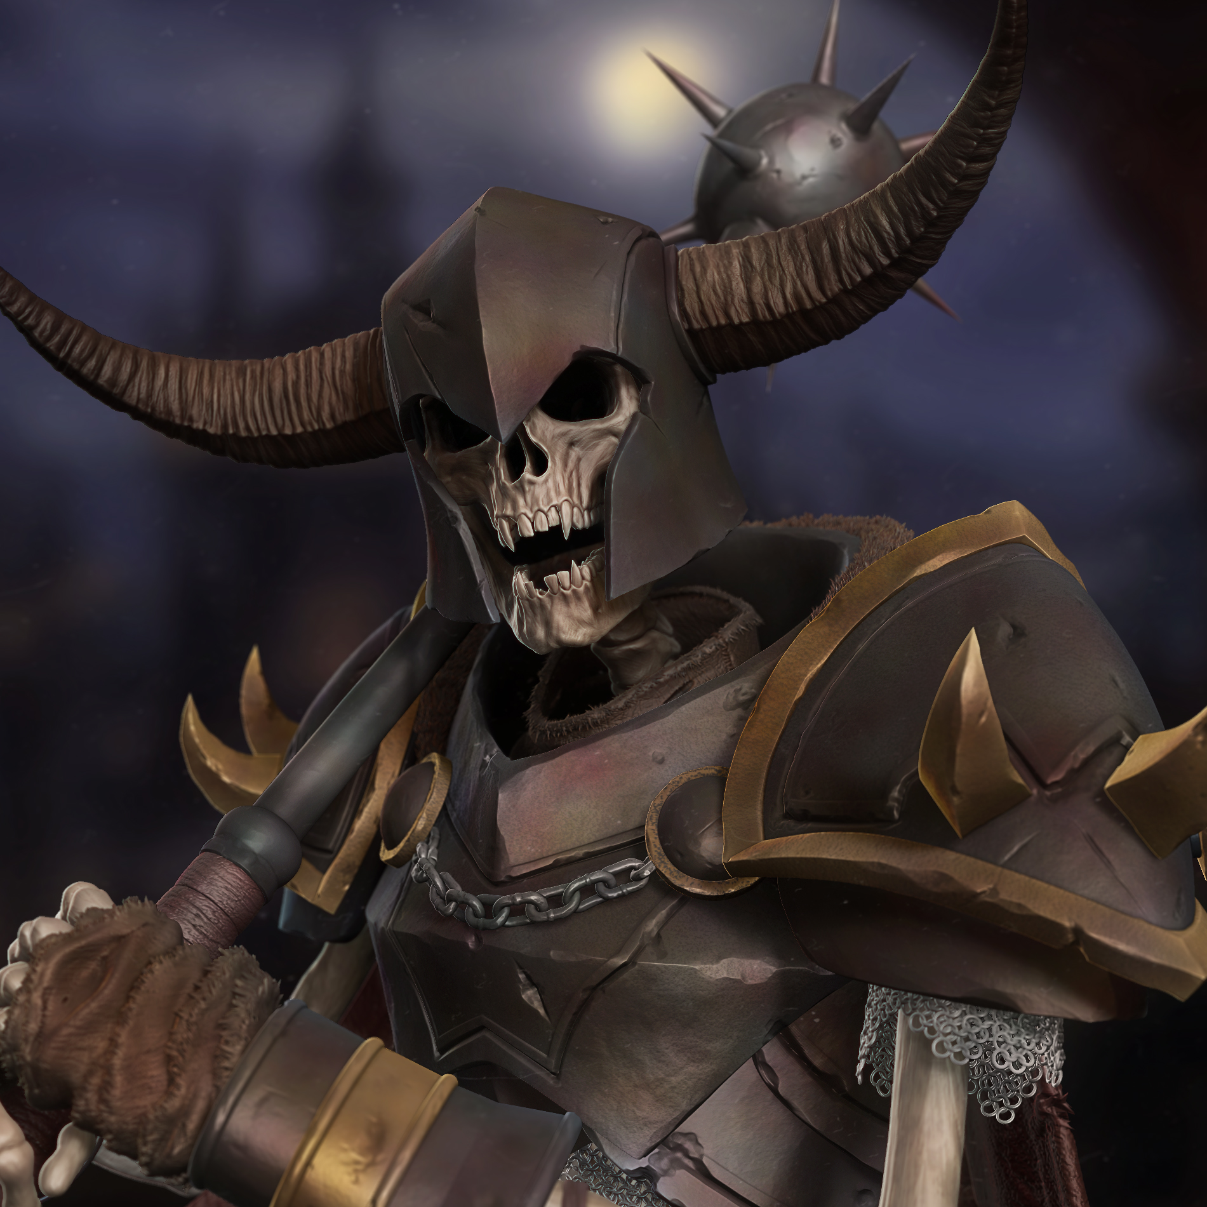
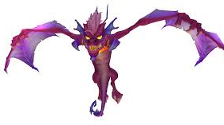
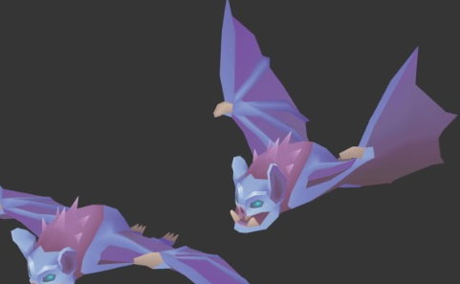
Enemies (Sculpting)- Wildwood/ Darkwood Biome
Wyverns
Bats
Skeleton Warriors
Goblins
Trolls
Ogres
Orcs

Slide 6
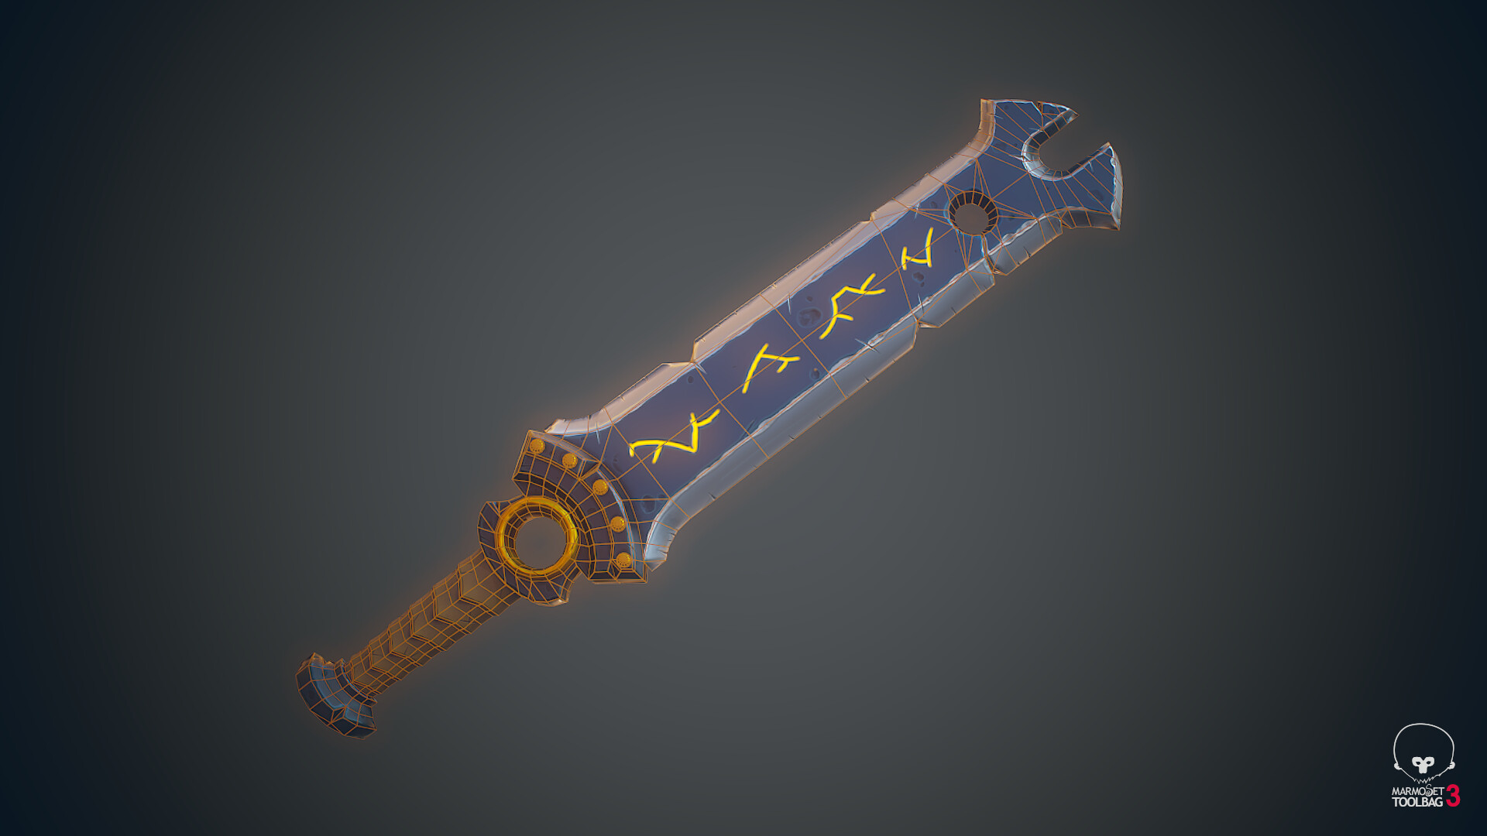
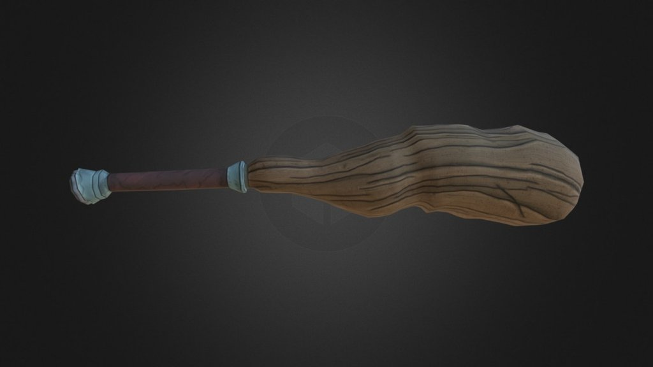
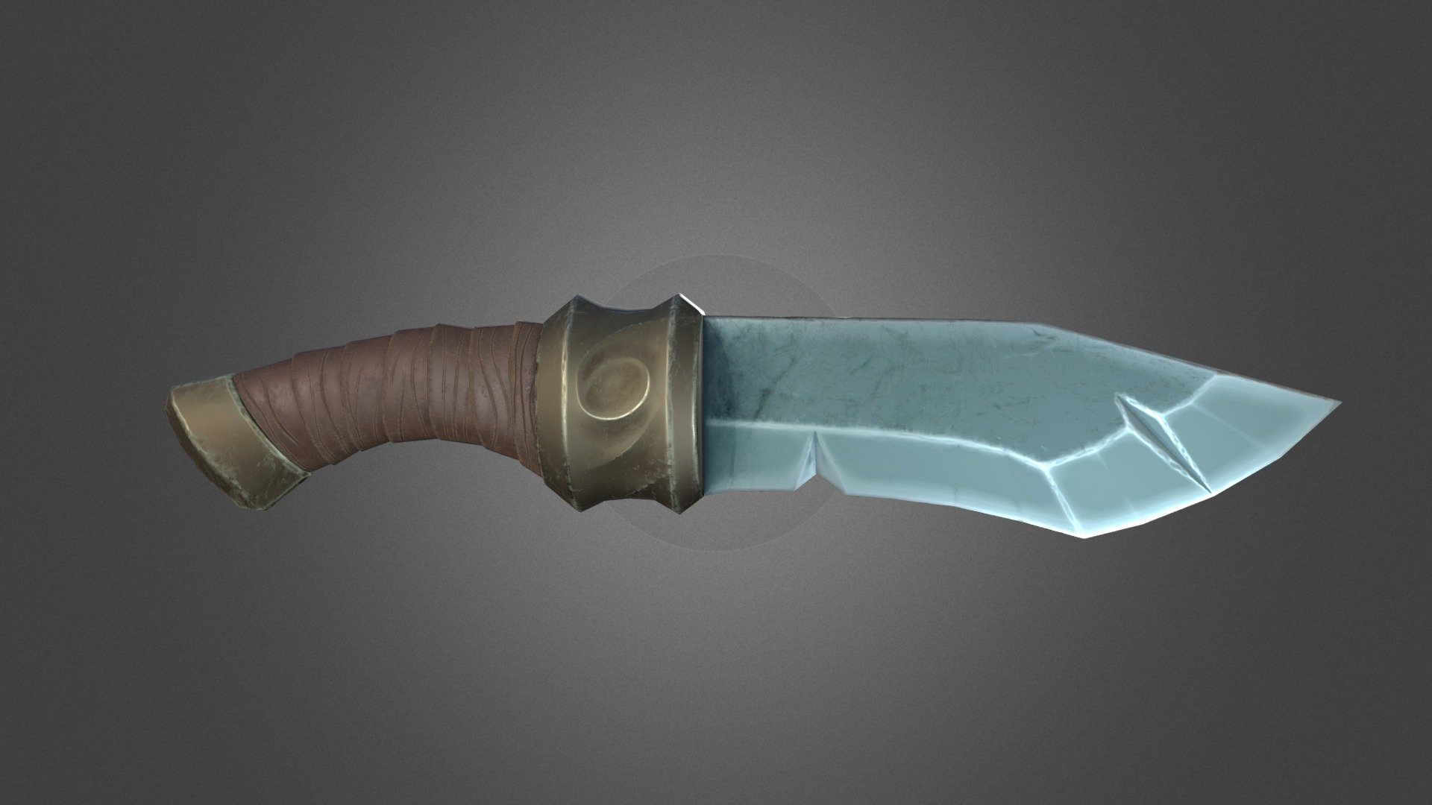
Common enemy weapons (Sculpting)
Old Sword
Old Dagger
And wooden clubs
Fists

Slide 7
Biome 2 enemies

Slide 8
Biome 3 enemies

Slide 9
Common Enemies for Wildwood/Darkwood Biome
Goblin
green-grey skin
Jagged teeth and glowing yellow eyes
Wears scraps of armour looted from corpses
Rusty knives, crude spears, and bone trinkets
Ogre
Massive, muscle-bound frame with sagging grey skin
Chains, skulls, and crude tattoos across its chest
Wields a tree trunk or iron club as a weapon
Troll
Towering, misshapen creature coated in moss and mud
Limbs too long, teeth like daggers
Carries no weapon
Skeleton Warrior
Reanimated bones wrapped in remnants of armour
Hollow eye sockets burn with ghostly light
Wields ancient weapons with rust
Wyvern and Bats
Wyverns attack with their sharp claws
Bats attack with their mouths
Both carry no physical weapon

Slide 10
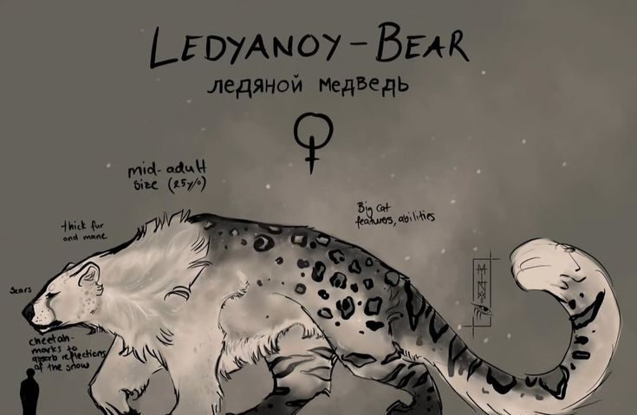
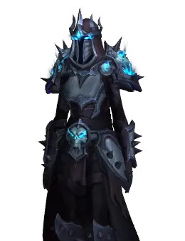
Boss Enemies (Sculpting)

Slide 11
Main Antagonist clothing and gear
Pale or ashen skin tone
Piercing, unnaturally coloured eyes (crimson, silver, void black, etc.)
Shadowed or scarred face
Long, tattered cloak or armour with occult engravings
Dark aura or faint mist emanating from the body
Clawed hands or marked skin (sigils, veins of corruption)
Silver hair, or black hair with streaks of white or crimson
Armor made of dark steel, bone, or dragon scales
Tattered hooded cloak or mantle of shadows
Rune-etched sword, cursed blade, or sentient weapon
Vial of blood, “soulstone” or cursed talisman
Bandolier of potions or forbidden relics
Ancient tome or grimoire bound in hide
Amulet bearing a forbidden crest or words that Claire drew up
Chains, spikes, or relics worn as trophies

